Slide 1
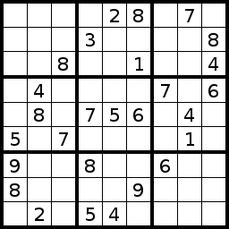
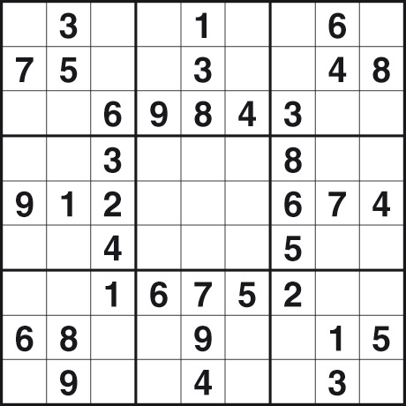
Sudoku Validator
By ANIRUDH BATRA (14BCE0602)
AND
SHUBHAM AHIRE (14BCE0352)

Slide 2
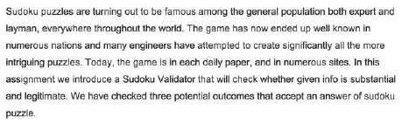
Introduction
Sudoku requires no calculation or arithmetic skills.
It is essentially a game of placing numbers in squares, using very simple rules of logic and deduction.
It can be played by children and adults and the rules are simple to learn.

Slide 3
Objective of Sudoku
The objective of the game is to fill all the blank squares in a game with the correct numbers. There are three very simple constraints to follow. In a 9 by 9 square Sudoku game:
Every row of 9 numbers must include all digits 1 through 9 in any order
Every column of 9 numbers must include all digits 1 through 9 in any order
Every 3 by 3 subsection of the 9 by 9 square must include all digits 1 through 9
Similarly, smaller Sudoku puzzles, such as the 4x4 puzzle, must have the numerals 1 through 4 in each row, column and subsection.
Larger Sudoku games (16 by 16) must have numerals 1 through 16 in each row, column and region. The principles are the same whatever the size of the game.

Slide 4
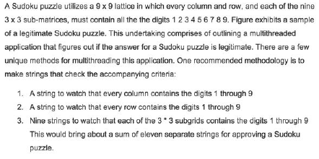
Problem Statement

Slide 5
PROCESS USED
Here we are using technique of
MULTITHREAD
And
MUTEX LOCK
Each thread either checks a row ,a column or a box

Slide 6
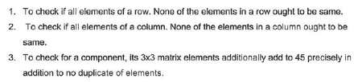
Methodology

Slide 7
Language used for implementation
We have successfully implemented Sudoku Validator using C++.
As such, the solution is trivial but considering addition of multithreading makes it more suitable for today’s world of fast computing and availability of high quality multi-processor systems.

Slide 8
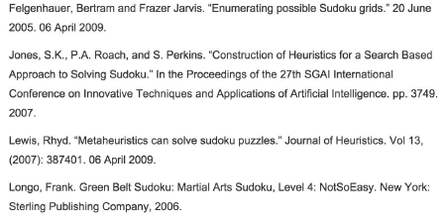
References

Slide 9
ALGORITHM
START
STEP:1 FIRST initialize data structure that contain the sudoku
STEP:2 initialize threads for each input using PTHREAD_CREATE
STEP:3 create function
void *runner(void *param)
to test each thread
STEP:4 read input using file commands
f = fopen(“path", "r“ )
and
fclose(f);
STEP:5 check if file is successfully parsed IF not goto STEP:4
STEP:6 create memory for the inputs

Slide 10
ALGORITHM
STEP:7 join the threads to compare using
PTHREAD_JOIN
STEP:8 NOW IN the function create a thread for each value
and compare it will every value in the corresponding
ROW and COLUMN
STEP:9 if (type == COLUMN)
set duplicate=TRUE;
STEP:10 if (type == ROW)
set duplicate=TRUE;

Slide 11
ALGORITHM
STEP:11 if type==any value in that region)
set duplicate=TRUE;
STEP:12 return duplicate;
STEP:13 if (duplicate == TRUE)
{
printf("Invalid Solution. A duplicate was found.\n");
}
else
{
printf("The solution appears to be valid =)\n");
}
END

